Slide 1

Azure Advanced Infrastructure Services
Scaling. Access and Security. Monitoring and Costs
SoftUni Team
Technical Trainers
Software University
https://softuni.org

Slide 2
Have a Questions?
sli.do
#azure-essentials
facebook.com
/groups/AzureEssentialsFebruary2022

Slide 3
Homework Progress

Slide 4

Previous Module (M1)
Quick Overview

Slide 5
What We Covered
Cloud Concepts
Azure Architecture
Azure Services, Products, and Solutions
Core Services
Management Tools

Slide 6
This Module (M2)
Topics

Slide 7
Table of Contents
Scaling
Network Security and Load Balancing
Monitoring
Azure Resource Manager (Templates)
Storage Blobs and Files
Resource Access and Security
Costs

Slide 8
Advanced Infrastructure Services
VM Scaling. Networking. Storage

Slide 9
Virtual Machine Scale Sets
Create and manage a group of identical, load balanced, and autoscaling VMs
Easy to create and manage multiple VMs
Provides high availability and application resiliency
Applications can automatically scale as resource demand changes
Works at large-scale
https://docs.microsoft.com/en-us/azure/virtual-machine-scale-sets/

Slide 10
VM Provision with Cloud Init
Configure a virtual machine or virtual machine scale sets at provisioning time
Scripts run on first boot once the resources have been provisioned
It is a widely used approach to customize Linux VMs
Installs packages and writes files, or configures users and security
Uses YAML
#cloud-config
package_upgrade: true
packages:
- httpd
https://docs.microsoft.com/en-us/azure/virtual-machines/linux/using-cloud-init

Slide 11
Networking (Security Groups)
Filter network traffic to and from Azure resources
Contain rules that allow or deny inbound or outbound traffic
Rules can have source and destination, port, and protocol
Evaluated by priority using the 5-tuple information
Can be applied to individual subnets within a VNet, NICs attached to a VNet, or both
Azure creates set of default rules in every security group
https://docs.microsoft.com/en-us/azure/virtual-network/security-overview

Slide 12
Networking (Load Balancer)
Allows the creation of highly available services
Four components:
Front end
A rule
A health probe
A back-end pool definition
Can be used as public or internal
Available in two pricing tiers - Basic and Standard
https://docs.microsoft.com/en-us/azure/load-balancer/

Slide 13
Azure Blob Storage
Designed for storing unstructured data
Used to store text files, images, videos, documents, etc.
Three types:
Block blobs are used to store files used by applications
Append blobs are like block blobs but are optimized for appending
Page blobs are optimized to store virtual hard drives (VHD)
Storage containers are used to organize blobs
https://<storage-acc>.blob.core.windows.net/<container>/<blob>
https://docs.microsoft.com/en-us/azure/storage/blobs/storage-blobs-introduction

Slide 14
Azure Files
Fully managed file shares in the cloud accessible via SMB
Can be mounted concurrently by cloud or on-premise deployments
Can be cached on Windows Servers with Azure File Sync
https://<storage-acc>.file.core.windows.net/<share>/<dir>/<file>
https://docs.microsoft.com/en-us/azure/storage/files/storage-files-introduction

Slide 15
Storage Access
Access Keys
Two 512-bit storage account access keys are automatically created
They are used for authorized access to a storage account via SAS
Can be rotated and regenerated without interruption to applications
Storage account key is like the root password for a storage account
Avoid distributing, hard-coding, or saving it anywhere in plaintext that
Shared Access Signature (SAS)
Used for granting granular access to resources
https://docs.microsoft.com/en-us/azure/storage/common/storage-account-manage

Slide 16
Azure Storage Explorer
Free tool to easily manage Azure cloud storage resources
Available for Windows, Linux, and macOS
Accessible, intuitive, feature-rich graphical user interface
Can work also disconnected from the cloud or offline with local emulators
https://azure.microsoft.com/en-us/features/storage-explorer/

Slide 17
Practice: Advanced Infra Services
VM Scaling. Networks. Storage

Slide 18
Security
Users. Roles. Policies

Slide 19
Users and Groups
Azure AD is used to give users access to Azure resources
Each user has an identity
User ID, a password, and other properties form the identity
Users also have one or more directory roles assigned
Groups are used to make it easier to manage larger groups of users
External (guest users) can be added via an invitation email
https://docs.microsoft.com/en-us/azure/active-directory/

Slide 20
Policies
Service in Azure that is used to create, assign, and manage policies
Every policy definition has conditions under which it's enforced
A policy assignment is a policy definition that has been assigned to take place within a specific scope
An initiative definition is a collection of policy definitions
An initiative assignment is an initiative definition assigned to a specific scope
Both policies and initiative definitions have parameters
https://docs.microsoft.com/en-us/azure/governance/policy/

Slide 21
Role-based Access Control (RBAC)
Provides fine-grained access management of Azure resources
Four elements:
The security principal represents an identity (user, group, app)
A role defines how the security principal can interact with a resource
The scope defines the level at which the role is applied
Role assignments – role assigned to a principal at a scope
Some of the built-in roles are Owner, Contributor, and Reader
Role assignments are additive
https://docs.microsoft.com/en-us/azure/role-based-access-control/

Slide 22
Resource Locks
Used to prevent accidental deletion or modification of a resource
Lock level can be set either to CanNotDelete or ReadOnly
Locks applied to parent are inherited by its children
Most restrictive lock in the inheritance takes precedence
https://docs.microsoft.com/en-us/azure/azure-resource-manager/resource-group-lock-resources

Slide 23
Azure Key Vault
Centralize application secrets
Securely store secrets and keys
Monitor access and use
Simplified administration of application secrets
Integrate with other Azure service
Two pricing tiers – Standard and Premium
https://docs.microsoft.com/en-us/azure/key-vault/

Slide 24
Practice: Security
Users. Roles. Policies

Slide 25
Monitoring and Control
Control Your Workload and Spending

Slide 26
Subscription Limits
Microsoft Azure limits are also called quotas
Raise of a limit or quota above the defaults is via support request
Free Trial subscriptions aren't eligible for limit or quota increases
Limits can't be raised above the maximum limit value
Limits can be on subscription or region level
https://docs.microsoft.com/en-us/azure/azure-subscription-service-limits

Slide 27
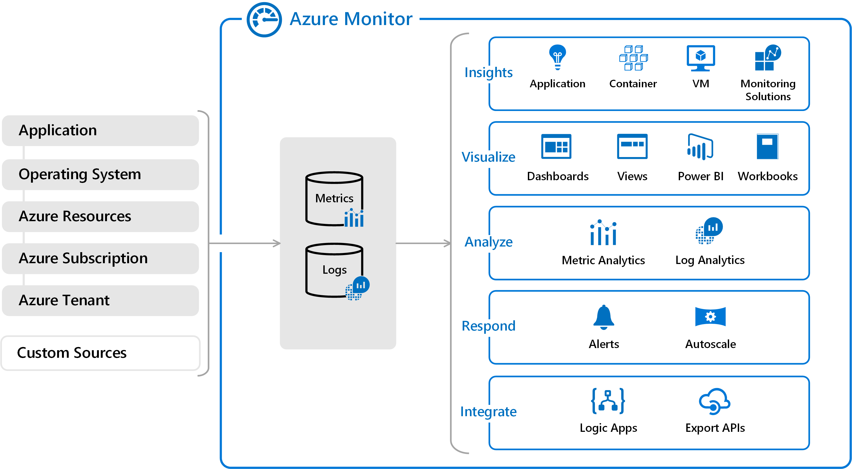
Azure Monitor
Metrics are numerical values that describe some aspect of a system at a particular point in time
Logs contain different kinds of data organized into records
Log queries use Kusto language
https://docs.microsoft.com/en-us/azure/azure-monitor/

Slide 28
Boot Diagnostics
For both Windows and Linux virtual machines screenshots are available
For Linux virtual machines the output of the console log is available
A storage account in which to place the diagnostic files is needed
The Boot diagnostics feature does not support premium storage account
https://docs.microsoft.com/en-us/azure/virtual-machines/troubleshooting/boot-diagnostics

Slide 29
Serial Console
Provides access to a text-based console for virtual machines (VMs) and virtual machine scale set instances
Available both for Linux or Windows instances
Connects to the ttyS0 or COM1 serial port
It can only be accessed by using the Azure portal
Allowed only for users with an access role of Contributor or higher
Boot diagnostics must be enabled for the VM
https://docs.microsoft.com/en-us/azure/virtual-machines/troubleshooting/serial-console-overview

Slide 30
Cost Management and Billing
Shows organizational cost and usage patterns with advanced analytics
Reports in Cost Management show the usage-based costs consumed by Azure services and third-party Marketplace offerings
Uses management groups, budgets, and recommendations to show how expenses are organized and how costs might be reduced
Offers cost analysis, budgets, recommendations, and exporting cost management data
https://docs.microsoft.com/en-us/azure/billing/

Slide 31
Budgets
Plan for and drive organizational accountability
Account for services consumption during a specific period
Monitor how spending progresses over time
When the budget thresholds are exceeded, only notifications are triggered
Budgets reset automatically at the end of a period
Resources are not affected, and consumption isn't stopped
https://docs.microsoft.com/en-us/azure/cost-management/tutorial-acm-create-budgets

Slide 32
Azure Advisor (1)
It is a best practices analyzer for Azure resources
Analyzes your resource configuration and usage telemetry
Recommends solutions that can:
Improve the cost effectiveness
Performance
Reliability
Security of resources
https://docs.microsoft.com/en-us/azure/advisor/

Slide 33
Azure Advisor (2)
The recommendations are divided into categories:
Cost
Security
Reliability (formerly called High Availability)
Operational Excellence
Performance
https://docs.microsoft.com/en-us/azure/advisor/

Slide 34
Pricing Calculator
Free on-line tool provided by Microsoft
Configure and estimate the costs for Azure products
Supports complex environment scenarios
Provides example scenarios
Offers to save and export the estimations
https://azure.microsoft.com/en-us/pricing/calculator/

Slide 35
Total Cost of Ownership Calculator
Free on-line tool provided by Microsoft
Estimate the cost savings if migrating our workloads to Azure
The emphasis is on the four core services
Expenses for software licenses, electricity, and labor are accounted
https://azure.microsoft.com/en-us/pricing/tco/calculator/

Slide 36
Tags
We can logically organize Azure resource by using tags
Each tag consists of a name and a value pair
Each resource can have a maximum of 50 tag name/value pairs
Not all resource types support tags
Tag name is limited to 512 (128 for storage accounts) characters
Tag value is limited to 256 characters
Tags applied to the resource group are not inherited by the resources
https://docs.microsoft.com/en-us/azure/azure-resource-manager/resource-group-using-tags

Slide 37
Additional Tools
To Gain Productivity

Slide 38
Visual Studio Code
Free multi-platform code editor
IntelliSence for syntax highlighting and autocompletion
Many languages are supported out of the box
Multiple source code management solutions supported
Azure integration
Extensible and customizable
https://code.visualstudio.com/

Slide 39
JMESPath
JMESPath is a query language for JSON
Hosted on-line
Developed and supported by 3rd party
http://jmespath.org/

Slide 40
Azure Resource Manager
Templates & Tools

Slide 41
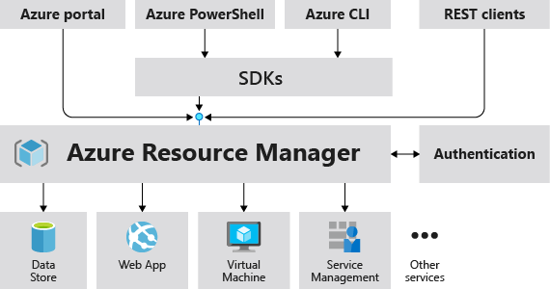
Azure Resource Manager
The deployment and management service for Azure
https://docs.microsoft.com/en-us/azure/azure-resource-manager/

Slide 42
Azure Resource Manager Templates
JSON file that defines one or more resources to deploy to a resource group or subscription
Can be used to deploy the resources consistently and repeatedly
Template is deployed only after passing validation
Can be broken into smaller, reusable components and linked together at deployment time. Nesting is also supported
Sections of a template are parameters, variables, user-defined functions, resources, and outputs
https://docs.microsoft.com/en-us/azure/azure-resource-manager/template-deployment-overview

Slide 43
ARMVIZ
Free tool for visualizing, editing, and saving Azure Resource Manager Templates
Hosted on-line
Developed and supported by 3rd party
http://armviz.io/

Slide 44
Practice: Azure The Right Way

Slide 45

Summary
Resource deployment process can be automated and reproduced using ARM templates
Initial provisioning of the VMs can be done via cloud init or custom script extension
Resource access management is implemented with RBAC
Policies can be used to track or enforce
Boot diagnostics require a storage account
Tags help to better track spending
Region and subscription limits can be increased to a maximum value via a support ticket

Slide 46
Questions?
Notes:
46

Slide 47













SoftUni Diamond Partners

Slide 48


Educational Partners

Slide 49

License
This course (slides, examples, demos, exercises, homework, documents, videos and other assets) is copyrighted content
Unauthorized copy, reproduction or use is illegal
© SoftUni – https://softuni.org
© Software University – https://softuni.bg
Notes:
49

Slide 50
Trainings @ Software University (SoftUni)
Software University – High-Quality Education, Profession and Job for Software Developers
softuni.bg, softuni.org
Software University Foundation
softuni.foundation
Software University @ Facebook
facebook.com/SoftwareUniversity
Software University Forums
forum.softuni.bg
Notes:
50

